Slide 1
By: Alexander Bridges, Jonathan Young, Eric Strayer, and Jacob Hu

Slide 2
User-end activities

Slide 3
Admin-end activities

Slide 4
Database Design

Slide 5
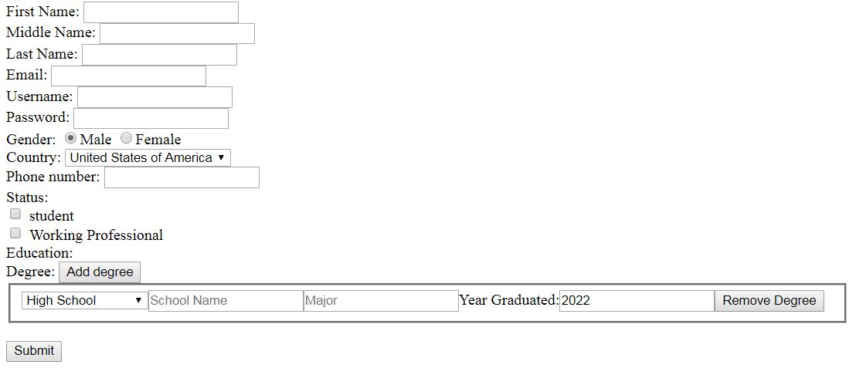
User Registration page

Slide 6
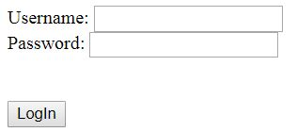
Login page

Slide 7
Alexander Bridges’ contributions

Slide 8
Jonathan Young’s contributions

Slide 9
Eric Strayer’s contributions

Slide 10
Jacob Hu’s contributions

